Slide 1

HR Metrics and Analytics Presentation
By: Tahani Alotaibi

Slide 2
Introduction
In this presentation, we will explore the HR Metrics and Analytics aimed at answering the four key business questions related to human resources at MNC. The goal of this analysis is to provide actionable insights to improve HR operations and increase the overall efficiency of the company.
Data Source
A comprehensive dataset available on the Kaggle platform was used. This data includes detailed information about employees, including satisfaction level, job performance, the number of projects they are working on, monthly working hours, work accidents, promotions, and different work departments. This data allows us to analyze the factors affecting employee retention, satisfaction, recruitment efficiency, and performance in a detailed and comprehensive manner.

Slide 3
The presentation will be structured to answer the following questions:
Employee Performance Analysis: What are the key factors affecting employee performance, and how can we enhance these factors to improve productivity?
Recruitment Efficiency: How can we improve the efficiency of the recruitment process to reduce time and cost while increasing the quality of accepted candidates?
Employee Retention Rate: What are the main factors affecting the employee retention rate in the company, and how can we improve these rates?
Employee Satisfaction: What are the key factors influencing employee satisfaction, and how can we enhance these factors to improve the work environment?

Slide 4
Employee Performance Analysis: What are the key factors affecting employee performance, and how can we enhance these factors to improve productivity?

Slide 5
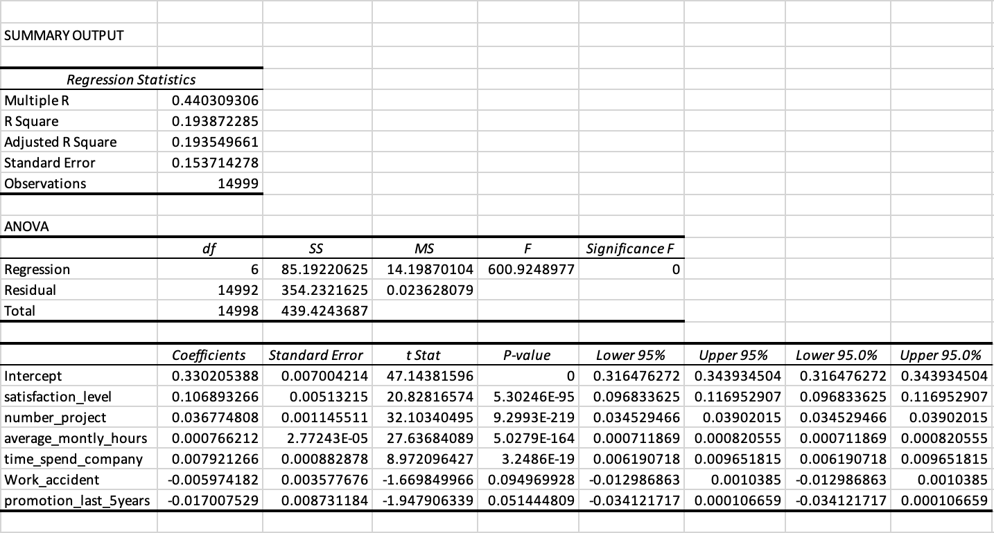
Satisfaction Level: It has a significant and statistically positive impact on job performance (P-value ≈ 0). Each unit increase in satisfaction level leads to an increase in job performance by 0.1068 units. Number of Projects: It has a significant and statistically positive impact on job performance (P-value ≈ 0). Each unit increase in the number of projects leads to an increase in job performance by 0.0367 units. Average Monthly Hours: It has a slight but statistically significant positive impact on job performance (P-value ≈ 0). The effect is very small (0.0007 per unit). Time Spent at Company: It has a significant and statistically positive impact on job performance (P-value ≈ 0). Each unit increase in the time spent at the company leads to an increase in job performance by 0.0079 units. Work Accidents: It has a negative but not statistically significant impact on job performance (P-value ≈ 0.1). The effect is negative by -0.0059 per unit. Promotion in Last 5 Years: It has a slight but not statistically significant negative impact on job performance (P-value ≈ 0.05). The effect is negative by -0.0170 per unit.
Through the multiple regression analysis conducted on the available data, we were able to identify the key factors affecting employee performance. The results are as follows:
We can see that the most influential factors on job performance are satisfaction level, number of projects, and time spent at the company. Therefore, the company can focus on improving these factors to enhance job performance. Regarding work accidents and promotions, although there are slight effects, they are not significant enough to cause immediate concern but can be monitored to improve overall performance.

Slide 6
Analysis of Key Factors Influencing Job Performance
1- Satisfaction Level
This scatter plot illustrates the relationship between the average satisfaction level and the average last evaluation score of employees. We can observe a general trend where higher satisfaction levels are associated with higher last evaluation scores. There are fluctuations indicating that while satisfaction is a strong predictor of performance, other factors might also influence the evaluation scores.
The scatter plot demonstrates a positive relationship between employee satisfaction and performance evaluation. Employees with higher satisfaction levels tend to receive higher performance evaluations, underscoring the importance of maintaining a satisfied workforce.
Based on the analysis, we conclude that satisfaction levels significantly impact employee performance.

Slide 7
Analysis of Key Factors Influencing Job Performance
2- Number of Projects:
This chart shows the relationship between the average last evaluation score and the number of projects employees are working on. It can be observed that employee performance tends to improve with an increasing number of projects, as the average last evaluation score rises with the number of projects.
The chart illustrates a positive correlation between the number of projects employees are involved in and their performance levels. Employees who participate in more projects tend to achieve better performance, suggesting that multiple challenges can serve as a motivator for enhanced performance.
Based on the analysis, we conclude that increasing the number of projects employees work on can lead to improved job performance. Therefore, the company should encourage employees to take on more projects and provide the necessary support to manage them effectively.

Slide 8
Analysis of Key Factors Influencing Job Performance
3- Average Monthly Hours:
This scatter plot illustrates the relationship between the average performance (last evaluation score) and the average monthly hours worked by employees. The plot shows that higher performance scores are generally associated with higher average monthly hours.
The scatter plot indicates a positive correlation between average monthly hours and employee performance. Employees who work more hours per month tend to receive higher evaluation scores, suggesting that increased working hours contribute to better performance.
Based on the analysis, it can be concluded that increasing average monthly working hours may lead to improved job performance. The company should consider monitoring and optimizing working hours to ensure employees are productive without experiencing burnout.

Slide 9
Analysis of Key Factors Influencing Job Performance
4- Time Spent at Company:
This line chart shows the relationship between average performance (last evaluation score) and tenure duration (number of years). It demonstrates how performance changes with increasing tenure duration.
The chart indicates that there is a fluctuation in performance based on tenure duration. Generally, it is observed that performance peaks when the tenure is between 4 and 6 years and then starts to decline slightly.
Based on this analysis, the company can focus on retaining employees for a tenure of 4 to 6 years, where performance reaches its highest point. To achieve this, the company can implement strategies to encourage employees to stay longer, such as providing training and development opportunities and promotions.

Slide 10
Analysis of Key Factors Influencing Job Performance
Non-Numeric Factors
In the multiple regression analysis, we analyzed only the numeric factors. However, there are important non-numeric factors that may impact job performance, such as salary level and the department in which the employee works. We represented these factors using charts to understand their influence on job performance.
5- Salary:
This pie chart illustrates the distribution of average job performance evaluations across three salary levels: high, medium, and low. Each segment of the pie chart represents a different salary level and its corresponding average performance evaluation score.
High Salary Level: Employees with a high salary level have an average performance evaluation score of 0.72, which constitutes 34% of the total evaluations.
Medium Salary Level: Employees with a medium salary level also have an average performance evaluation score of 0.72, making up 33% of the total evaluations.
Low Salary Level: Employees with a low salary level have a slightly lower average performance evaluation score of 0.70, which represents 33% of the total evaluations.
The analysis shows that there is a slight variation in job performance evaluations based on salary levels. Employees with high and medium salary levels tend to have similar performance evaluation scores, which are marginally higher than those with low salary levels. This suggests that higher salary levels may be associated with slightly better job performance. However, the difference is not substantial enough to indicate a strong correlation. Therefore, while salary level might have a minor influence on job performance, other factors likely play a more significant role in determining overall job performance.

Slide 11
Analysis of Key Factors Influencing Job Performance
6- Department
This bar chart shows the average performance evaluation scores for employees across various departments. Each bar represents a different department and its corresponding average performance evaluation score.
Highest Scores: Management and support departments (~0.73).
Moderate Scores: Technical, accounting, IT, marketing, product management, and RandD departments (0.70 - 0.72).
Lowest Scores: Sales and HR departments (~0.70).
The analysis reveals that there are variations in job performance evaluations across different departments. Management and support departments have the highest average performance evaluations, indicating potentially better performance in these areas. On the other hand, HR and sales departments have the lowest average performance evaluations, suggesting areas that might require further attention to improve performance.

Slide 12
Conclusions and Recommendations
Conclusions
We observe that there are five factors affecting employee performance:
Satisfaction Level: Found to have a statistically significant positive impact on job performance.
Number of Projects: Found to have a statistically significant positive impact on job performance.
Average Monthly Hours: Has a slight but statistically significant positive impact on job performance.
Time Spent at Company: Has a statistically significant positive impact on job performance.
Department: Variations in job performance were observed between different departments.
Recommendations
1-To improve satisfaction levels, I suggest providing a supportive and motivating work environment, enhancing communication between employees and management, offering performance-based incentives and rewards, organizing social events and recreational activities to foster team spirit, and developing flexible work policies that allow for remote work when needed.
2- Encourage employees to participate in multiple projects and present them with new and diverse challenges to develop their skills and motivate them. Provide the necessary training and support to manage projects effectively and ensure the workload is distributed fairly among employees to prevent burnout.
3- Monitor and optimize working hours to prevent burnout and provide flexibility in work schedules to ensure a balance between professional and personal life. Additionally, offer programs to train employees on effective time management.
4- Provide clear promotion pathways and encourage retention by offering long-term incentives, professional development programs, and clear growth opportunities.
5- Identify low-performing departments and provide necessary support to improve them (such as HR and Sales in this case). Organize training sessions and workshops to enhance the required skills in these departments and promote collaboration between different departments to share experiences and best practices.

Slide 13
2.Recruitment Efficiency:
How can we improve the efficiency of the recruitment process to reduce time and cost while increasing the quality of accepted candidates?

Slide 14
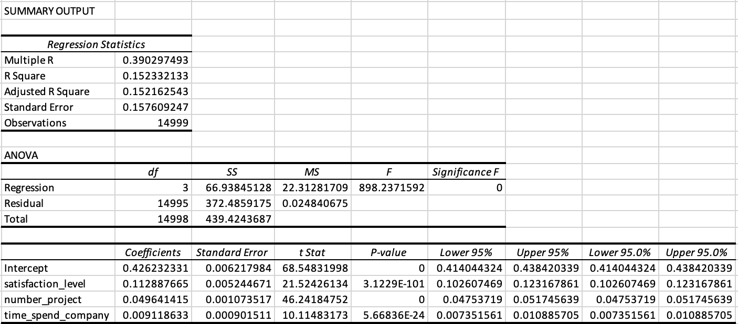
Through the multiple regression analysis conducted on the available data, we were able to identify the key factors affecting recruitment quality by their impact on employee performance. The results are as follows: Satisfaction Level: It has a significant and statistically positive impact on job performance (P-value ≈ 0). Each unit increase in satisfaction level leads to an increase in job performance by 0.1128 units. Number of Projects: It has a significant and statistically positive impact on job performance (P-value ≈ 0). Each unit increase in the number of projects leads to an increase in job performance by 0.0496 units. Time Spent at Company: It has a significant and statistically positive impact on job performance (P-value ≈ 0). Each unit increase in the time spent at the company leads to an increase in job performance by 0.0091 units.
Although the necessary data for analyzing the improvement of the recruitment process is not available, such as:
Time to hire (the time taken to hire each employee from opening the position to accepting the offer)
Recruitment cost (the cost of each hiring process, taking into account advertisement costs, the time of employees involved in the process, and any other related costs)
Quality of hire (initial evaluations of new employees after the probation period, such as 3 or 6 months)
Offer acceptance rate (the rate at which candidates accept job offers)
We can still focus on analyzing the available data and extracting possible insights and recommendations. We will use statistical tools to analyze factors that could be related to recruitment quality, such as satisfaction level, number of projects, and tenure duration. By studying the relationship between these factors and employee performance, we can draw conclusions that may help improve the recruitment process and overall employee performance.
We can see that the most influential factors on job performance are satisfaction level, number of projects, and time spent at the company. Therefore, the company can focus on improving these factors to enhance job performance and, thus, enhance recruitment quality.

Slide 15
Analysis of Key Factors Influencing Recruitment Efficiency
1- Satisfaction Level
This scatter plot illustrates the relationship between the average satisfaction levels of employees and their last evaluation scores. By analyzing this relationship, we can gain insights into how employee satisfaction correlates with performance, which is a critical factor in recruitment quality.
Positive Correlation: Higher satisfaction levels generally correspond to higher performance evaluations. This suggests that satisfied employees tend to perform better.
Clustered Distribution: The data points are clustered in several distinct groups, indicating potential patterns or segments within the employee population that can be further investigated.
Enhancing employee satisfaction can lead to improved performance, which in turn can improve recruitment quality by attracting and retaining high-performing individuals.

Slide 16
Analysis of Key Factors Influencing Recruitment Efficiency
2- Number of Projects:
This bar chart illustrates the relationship between the number of projects employees are working on and their last evaluation scores. By analyzing this relationship, we can gain insights into how involvement in multiple projects correlates with employee performance, which can inform recruitment strategies.
Positive Correlation: There is a clear positive trend indicating that as the number of projects increases, the average performance evaluation also increases.
Optimal Project Load: Employees involved in 6-7 projects tend to have the highest performance scores, suggesting an optimal project load that maximizes productivity and performance.
Encouraging employees to participate in multiple projects can enhance their performance. For recruitment, this implies that candidates with the ability to manage and excel in multiple projects should be prioritized, and providing sufficient support and training for project management can further improve recruitment quality and efficiency.

Slide 17
Analysis of Key Factors Influencing Recruitment Efficiency
3- Time Spent at Company:
This line chart shows the relationship between the tenure duration of employees (number of years spent at the company) and their last evaluation scores. By examining this relationship, we can understand how the length of time an employee spends at the company influences their performance, which can provide insights for improving recruitment efficiency.
Fluctuations in Performance: The chart indicates that employee performance varies with tenure duration. Performance peaks around 4-6 years of tenure and then starts to decline slightly.
Retention Strategies: Employees with 4-6 years of tenure show the highest performance levels, suggesting that this period is crucial for maximizing employee productivity.
To enhance recruitment efficiency, the company should focus on retention strategies that encourage employees to stay for at least 4-6 years. This can be achieved by offering career development opportunities, recognition programs, and clear paths for advancement within the company.

Slide 18
Conclusions and Recommendations
Conclusions
We observe that there are three key factors affecting recruitment quality by their impact on employee performance:
Satisfaction Level: Found to have a statistically significant positive impact on job performance.
Number of Projects: Found to have a statistically significant positive impact on job performance.
Time Spent at Company: Found to have a statistically significant positive impact on job performance.
Recommendations
1-To improve satisfaction levels: I suggest providing a supportive and motivating work environment, enhancing communication between employees and management, offering performance-based incentives and rewards, organizing social events and recreational activities to foster team spirit, and developing flexible work policies that allow for remote work when needed.
2- Encourage employees to participate in multiple projects and present them with new and diverse challenges to develop their skills and motivate them. Provide the necessary training and support to manage projects effectively and ensure the workload is distributed fairly among employees to prevent burnout.
3- Monitor and optimize working hours to prevent burnout and provide flexibility in work schedules to ensure a balance between professional and personal life. Additionally, offer programs to train employees on effective time management.

Slide 19
3. Employee Retention Rate:
What are the main factors affecting the employee retention rate in the company, and how can we improve these rates?

Slide 20
We observe that the employee turnover rate (24%) is considered average, indicating that the company needs to improve employee retention strategies to reduce this rate. The employee retention rate (76%) is relatively positive, but it can be improved by focusing on the factors that significantly impact employee retention.

Slide 21
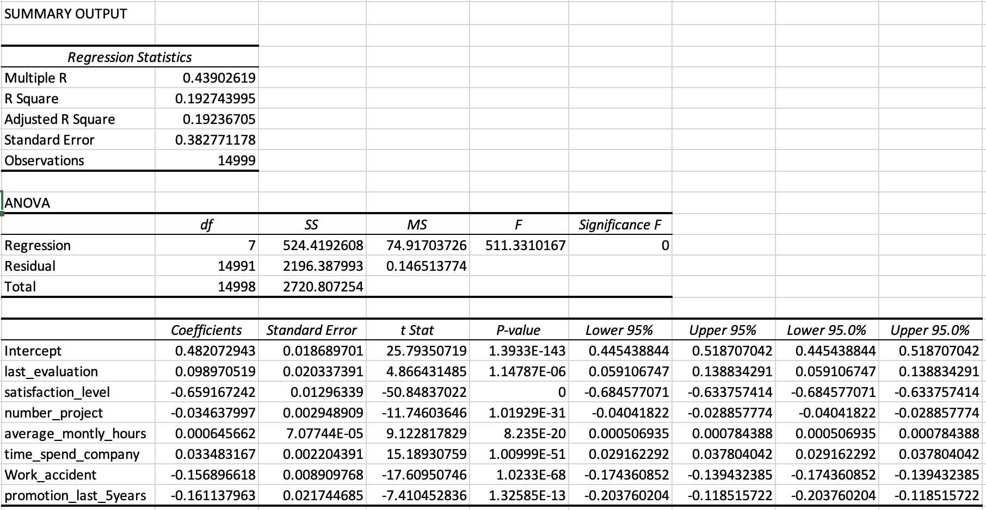
Last Evaluation: It has a significant and statistically positive impact on the likelihood of employees staying with the company (P-value ≈ 0). Each unit increase in the last evaluation score leads to an increase in the likelihood of employees staying by 0.0989 units. This indicates that employees with higher evaluations tend to remain with the company. Satisfaction Level: It has a significant and statistically negative impact on the likelihood of employees staying with the company (P-value ≈ 0). Each unit increase in satisfaction level leads to a decrease in the likelihood of employees staying by 0.6592 units. This suggests that employees with higher satisfaction levels may be more likely to leave the company in search of better opportunities. Number of Projects: It has a significant and statistically negative impact on the likelihood of employees staying with the company (P-value ≈ 0). Each unit increase in the number of projects leads to a decrease in the likelihood of employees staying by 0.0346 units. This indicates that an increased number of projects can reduce the likelihood of employees staying due to increased workload and burnout. Average Monthly Hours: It has a significant and statistically positive impact on the likelihood of employees staying with the company (P-value ≈ 0). Each unit increase in average monthly hours leads to an increase in the likelihood of employees staying by 0.0006 units. Time Spent at Company: It has a significant and statistically positive impact on the likelihood of employees staying with the company (P-value ≈ 0). Each unit increase in the time spent at the company leads to an increase in the likelihood of employees staying by 0.0335 units. This indicates that employees who spend more time at the company are more likely to stay longer. Work Accidents: It has a significant and statistically negative impact on the likelihood of employees staying with the company (P-value ≈ 0). Each unit increase in work accidents leads to a decrease in the likelihood of employees staying by 0.1569 units. Promotion in Last 5 Years: It has a significant and statistically negative impact on the likelihood of employees staying with the company (P-value ≈ 0). Each unit increase in promotions in the last 5 years leads to a decrease in the likelihood of employees staying by 0.1611 units.
From the multiple regression analysis conducted on the available data, we were able to identify the key factors affecting the employee departure rate (left). The results are as follows:
We can see that the most influential factors on the likelihood of employees staying with the company are the last evaluation, satisfaction level, number of projects, average monthly hours, time spent at the company, work accidents, and promotions in the last 5 years. Therefore, the company can focus on improving these factors to enhance employee retention.

Slide 22
Analysis of Key Factors Influencing Employee Retention Rate
1- Satisfaction Level
This bar chart illustrates the relationship between average satisfaction levels of employees and their retention status. By analyzing this relationship, we can gain insights into how employee satisfaction correlates with retention, which is a critical factor for the organization.
Positive Correlation: Higher satisfaction levels generally correspond to higher retention rates. This suggests that satisfied employees tend to stay with the company longer.
Clear Difference: The chart shows a clear difference in average satisfaction levels between employees who stay and those who leave. Employees who stay have an average satisfaction level of approximately 0.67, whereas those who leave have an average satisfaction level of approximately 0.44.
Enhancing employee satisfaction can lead to improved retention rates, thereby reducing turnover and maintaining a stable and committed workforce.

Slide 23
Analysis of Key Factors Influencing Employee Retention Rate
2- Last Evaluation
This bar chart illustrates the relationship between employees' last evaluation scores and their retention status. By analyzing this relationship, we can see how the last performance evaluation correlates with employee retention.
Positive Statistical Impact: According to the multiple regression analysis, the last evaluation score has a significant and statistically positive impact on the likelihood of employees staying with the company (P-value ≈ 0). Each unit increase in the last evaluation score leads to an increase in the likelihood of employees staying by 0.0989 units. This indicates that employees with higher evaluations tend to remain with the company.
Minimal Difference in Chart: However, the bar chart shows a minimal difference in the average last evaluation scores between employees who stay and those who leave. Both groups have similar average scores, around 0.70.
The minimal difference in the chart suggests that while last evaluation scores do have a positive impact on retention as shown by the regression analysis, they might not be the sole factor influencing retention. It may be necessary to consider other factors alongside performance evaluations to develop a comprehensive retention strategy.
Maintaining fair and accurate performance evaluations is important, but to enhance employee retention effectively, a holistic approach considering multiple factors is essential.

Slide 24
Analysis of Key Factors Influencing Employee Retention Rate
3- Number of Projects
This bar chart illustrates the relationship between the number of projects employees handle and their retention status. By analyzing this relationship, we can gain insights into how the workload in terms of project count correlates with employee retention.
Significant Statistical Impact: According to the multiple regression analysis, the number of projects has a significant and statistically negative impact on the likelihood of employees staying with the company (P-value ≈ 0). Each unit increase in the number of projects leads to a decrease in the likelihood of employees staying by 0.0346 units. This indicates that employees with a higher number of projects tend to leave the company.
Distribution Insights: The chart shows that employees who handle a moderate number of projects (3-4) tend to stay longer compared to those handling either a very high or very low number of projects. There is a noticeable drop in retention for employees involved in 5 or more projects, which suggests potential burnout or dissatisfaction with workload.
From the analysis, we find that the number of projects significantly impacts employee retention rates. The chart shows that employees working on a moderate number of projects tend to stay longer with the company, while those working on a higher number of projects are more likely to leave. Therefore, it is important for the company to effectively manage the number of projects assigned to employees to avoid burnout and increase retention rates.

Slide 25
Analysis of Key Factors Influencing Employee Retention Rate
4- Average Monthly Hours
This bar chart illustrates the relationship between average monthly hours worked by employees and their retention status. By analyzing this relationship, we can gain insights into how the amount of work time correlates with employee retention.
Significant Statistical Impact: According to the multiple regression analysis, the average monthly hours have a slight but statistically significant positive impact on the likelihood of employees staying with the company (P-value ≈ 0). Each unit increase in average monthly hours leads to a minimal increase in the likelihood of employees staying by 0.0006 units.
Distribution Insights: The chart shows that the average monthly hours for employees who stay (approximately 207 hours) are slightly higher than those who leave (approximately 199 hours). Although the difference is small, it suggests that employees who work slightly more hours tend to stay with the company longer.
From the analysis, it is evident that while average monthly hours have a minimal impact on employee retention, managing workload effectively is crucial. Ensuring that employees do not feel overworked or underworked can contribute to higher retention rates.

Slide 26
Analysis of Key Factors Influencing Employee Retention Rate
5- Time Spent at Company:
This bar chart illustrates the relationship between employees' tenure duration and their retention status. By analyzing this relationship, we can understand how the length of time an employee stays at the company impacts the likelihood of retention.
Significant Statistical Impact: According to the multiple regression analysis, tenure duration has a significant and statistically positive impact on the likelihood of employees staying with the company (P-value ≈ 0). Each unit increase in tenure duration leads to an increase in the likelihood of employees staying by 0.0335 units. This indicates that employees who have been with the company for a longer time tend to stay longer.
Distribution Insights: The chart shows that employees with a tenure of 2 to 4 years tend to stay longer compared to those who have been with the company for less than 2 years or more than 4 years. There is a noticeable drop in retention for employees who have been with the company for more than 5 years, suggesting potential burnout or dissatisfaction.
This suggests that employees who stay longer in the company may feel a sense of stability and attachment. However, very long tenures can lead to feelings of burnout or dissatisfaction, affecting retention rates.

Slide 27
Analysis of Key Factors Influencing Employee Retention Rate
6-Work Accidents
This bar chart illustrates the relationship between the occurrence of work accidents and employee retention status. By analyzing this relationship, we can understand how work accidents impact the likelihood of employees staying with the company.
Significant Statistical Impact: According to the multiple regression analysis, work accidents have a significant and statistically negative impact on the likelihood of employees staying with the company (P-value ≈ 0). Each unit increase in work accidents leads to a decrease in the likelihood of employees staying by 0.1569 units. This indicates that employees who experience more work accidents are more likely to leave the company.
Distribution Insights: The chart shows a noticeable difference in retention between employees who experienced work accidents and those who did not. Employees who did not experience work accidents (approximately 9428) tend to stay with the company longer, whereas those who did experience work accidents (approximately 169) have a higher likelihood of leaving.
This suggests that work accidents significantly affect employee retention, with a higher number of accidents correlating with a higher likelihood of employees leaving the company. This could be due to dissatisfaction with workplace safety and the work environment.

Slide 28
Analysis of Key Factors Influencing Employee Retention Rate
7- Promotions in the Last 5 Years
This bar chart illustrates the relationship between the frequency of promotions in the last five years and employee retention status. By analyzing this relationship, we can gain insights into how career advancement opportunities impact the likelihood of employees staying with the company.
Significant Statistical Impact: According to the multiple regression analysis, the number of promotions in the last five years has a significant and statistically negative impact on the likelihood of employees staying with the company (P-value ≈ 0). Each unit increase in promotions leads to a decrease in the likelihood of employees staying by 0.1611 units. This indicates that employees with more promotions tend to leave the company.
Distribution Insights: The chart shows a noticeable difference in retention between employees who received promotions and those who did not. Employees who did not receive promotions (approximately 9428) tend to stay with the company longer, whereas those who received promotions (approximately 169) have a higher likelihood of leaving.
This suggests that while promotions are generally considered positive, frequent promotions may be associated with higher turnover rates. This could be due to employees seeking new challenges or opportunities elsewhere after receiving several promotions within the company.

Slide 29
Analysis of Key Factors Influencing Employee Retention Rate
8- Salary Level
This bar chart illustrates the relationship between salary levels and employee retention status. By analyzing this relationship, we can gain insights into how different salary levels impact the likelihood of employees staying with the company.
Distribution Insights: The chart shows that employees with medium and low salary levels tend to stay longer with the company compared to those with high salary levels. Employees with low salaries (approximately 7,261) and medium salaries (approximately 6,446) show higher retention rates, whereas employees with high salaries (approximately 1,237) have a higher likelihood of leaving.
This suggests that while higher salaries generally contribute to employee retention, there might be other factors at play for employees with high salaries, leading to higher turnover rates. These factors could include job satisfaction, career development opportunities, and work-life balance, which should be considered in retention strategies.

Slide 30
Analysis of Key Factors Influencing Employee Retention Rate
9- Department
This bar chart illustrates the relationship between different departments and employee retention status. By analyzing this relationship, we can gain insights into how the department in which employees work impacts the likelihood of them staying with the company.
Distribution Insights: The chart shows noticeable differences in retention rates across various departments. For example, the sales and support departments have the highest number of employees who leave, whereas the technical and IT departments have higher retention rates. This variation indicates that employees in some departments may experience higher job satisfaction, better working conditions, or more supportive management, leading to increased retention.
Understanding the factors contributing to higher retention rates in specific departments can help the company implement targeted strategies to improve retention across all departments.

Slide 31
Conclusions and Recommendations
Conclusions
We have identified 9 factors that influence employee retention rates:
Satisfaction Level: Employees with higher satisfaction levels tend to stay with the company longer.
Last Evaluation: Employees who receive higher scores in their last evaluation tend to stay with the company, although the difference in scores is small.
Number of Projects: Employees handling a moderate number of projects tend to stay longer, while handling very high or very low numbers of projects can lead to lower retention rates.
Average Monthly Hours: Employees who work slightly more monthly hours tend to stay longer, though the difference is small.
Time Spent at Company: Employees with a tenure of 2 to 4 years tend to stay longer. Tenures longer than five years may indicate potential burnout or dissatisfaction.
Work Accidents: Employees who experience more work accidents are more likely to leave the company.
Promotions in the Last 5 Years: More frequent promotions are associated with higher turnover rates.
Salary Level: Higher salaries generally correlate with higher retention rates, although other factors may also play a role.
Department: Retention rates vary across different departments, with some departments having higher retention rates than others.
Recommendations
1- To improve satisfaction levels, provide a more supportive and comfortable work environment, and conduct regular employee surveys to gauge their satisfaction levels and take action based on the results. Additionally, enhance the work-life balance.
2- Manage the number of projects assigned to employees effectively to avoid burnout and increase retention rates, ensuring tasks are distributed fairly among employees and avoiding overloading any single employee with too many projects.
3- Effectively manage work hours to ensure employees do not feel overworked or excessively stressed by monitoring overtime hours and ensuring employees receive adequate breaks. Additionally, offer flexible work options or remote work opportunities if feasible.
4- Provide opportunities for career development and internal mobility to ensure that employees stay longer without feeling burnout or dissatisfaction.
5- Improve workplace safety measures and reduce the occurrence of accidents by providing regular safety training and strictly adhering to safety protocols. Ensure a safe work environment to enhance employee satisfaction and retention rates.
6- Regularly review the salary structure to ensure market competitiveness, and provide additional incentives and bonuses for high-performing employees.
7- Understanding the factors contributing to higher retention rates in different departments and implementing targeted strategies to improve retention across all departments. Address issues such as workload, career development opportunities, and workplace culture to enhance employee satisfaction and reduce turnover rates in departments with lower retention rates.

Slide 32
4. Employee Satisfaction: What are the key factors influencing employee satisfaction, and how can we enhance these factors to improve the work environment?

Slide 33
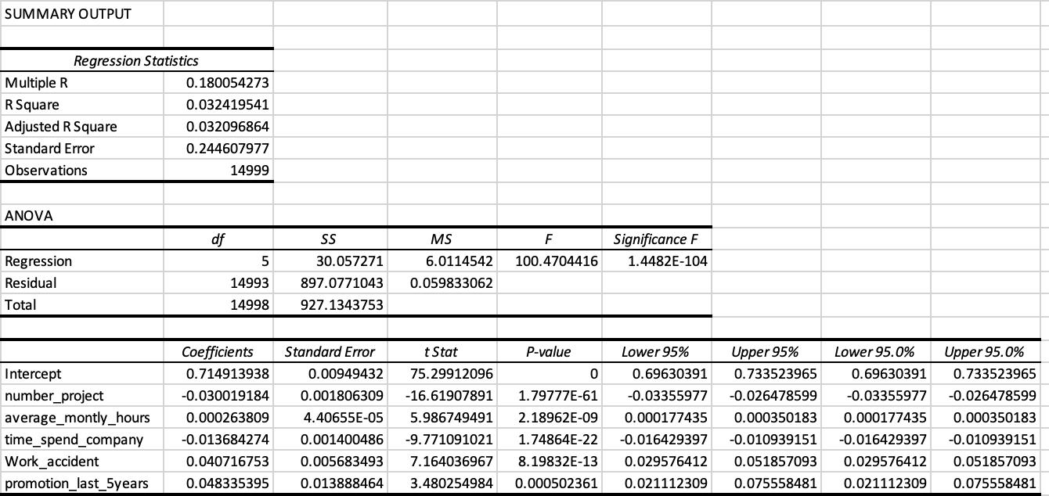
Number of Projects: It has a statistically significant negative impact on employee satisfaction levels (P-value ≈ 0). Each unit increase in the number of projects leads to a decrease in satisfaction levels by 0.0300 units. Average Monthly Hours: It has a slight but statistically significant positive impact on employee satisfaction levels (P-value ≈ 0). The effect is very small (0.0003 per unit). Time Spent at Company: It has a statistically significant negative impact on employee satisfaction levels (P-value ≈ 0). Each unit increase in tenure leads to a decrease in satisfaction levels by 0.0137 units. Work Accidents: It has a statistically significant positive impact on employee satisfaction levels (P-value ≈ 0). Each unit increase in the number of work accidents leads to an increase in satisfaction levels by 0.0407 units. Promotions in the Last 5 Years: It has a statistically significant positive impact on employee satisfaction levels (P-value ≈ 0). Each unit increase in the number of promotions leads to an increase in satisfaction levels by 0.0483 units.
Based on the multiple regression analysis conducted on the available data, we identified the key factors affecting employee satisfaction levels. The results are as follows:
We can see that the most influential factors on employee satisfaction levels are the number of projects, tenure, work accidents, and promotions in the last 5 years. Therefore, the company can focus on improving these factors to enhance employee satisfaction levels.

Slide 34
The apparent difference between the positive impact of the number of projects on employee performance and the negative impact on their satisfaction level can be explained in detail as follows:
Impact of the Number of Projects on Employee Performance:
Skill Development and Experience: With an increase in the number of projects, employees may face new challenges and diverse tasks that contribute to developing their skills and increasing their experience. These challenges can be motivating and encourage employees to put in more effort to achieve better performance.
Handling multiple projects can enhance employee performance in terms of productivity and efficiency.
Impact of the Number of Projects on Employee Satisfaction:
Workload and Fatigue: On the other hand, increasing the number of projects can lead to an increased workload and fatigue, which may negatively affect the overall satisfaction level of employees. Employees who feel they are carrying an excessive workload may suffer from stress and lack of time to achieve a work-life balance.
An excessive number of projects can lead to a decrease in employee satisfaction due to feelings of exhaustion and pressure.

Slide 35
Analysis of Key Factors Influencing Employee Satisfaction
1- Number of Projects:
This bar chart illustrates the relationship between the number of projects and average satisfaction levels across different departments.
Significant Statistical Impact: It has a statistically significant negative impact on employee satisfaction levels (P-value ≈ 0). Each unit increase in the number of projects leads to a decrease in satisfaction levels by 0.0300 units.
Distribution Insights: The chart shows noticeable differences in average satisfaction levels across departments:
Accounting, Product Management: Higher satisfaction with a moderate number of projects.
HR, IT, Sales, Support, Technical: Satisfaction decreases significantly with more projects.
Management, Marketing: Satisfaction remains stable with moderate projects but decreases with higher numbers.
R&D: Higher satisfaction with fewer projects, decreasing as project count rises.
Balancing project workload is crucial for maintaining employee satisfaction. Understanding these factors can help the company implement strategies to improve satisfaction across departments.

Slide 36
Analysis of Key Factors Influencing Employee Satisfaction
2- Time Spent at Company:
This line chart illustrates the relationship between the average satisfaction level and the number of years employees have spent at the company. By analyzing this relationship, we can gain insights into how tenure impacts employee satisfaction.
Time Spent at Company: It has a statistically significant negative impact on employee satisfaction levels (P-value ≈ 0). Each unit increase in tenure leads to a decrease in satisfaction levels by 0.0137 units.
Distribution Insights: The chart indicates that employees who have been with the company for 2 years have the highest satisfaction levels. There is a noticeable dip in satisfaction for employees with 4 years of tenure, followed by a gradual increase for those with longer tenure. This pattern suggests that while initial years may be more satisfying, mid-tenure could pose challenges, which then stabilize as employees continue their careers with the company.
Understanding these trends can help the company implement targeted strategies to improve employee satisfaction across different tenure periods.

Slide 37
Analysis of Key Factors Influencing Employee Satisfaction
3- Work Accident Status:
These pie charts illustrate the relationship between average satisfaction levels and the presence of work accidents. By analyzing this relationship, we can gain insights into how safety in the workplace impacts employee satisfaction.
Significant Statistical Impact: It has a statistically significant positive impact on employee satisfaction levels (P-value ≈ 0). Each unit increase in the number of accidents leads to an increase in satisfaction levels by 0.0407 units.
Distribution Insights: Employees who have experienced work accidents report slightly higher satisfaction levels compared to those who have not. This may suggest that the company's response to accidents, such as support and compensation, positively affects satisfaction.
4- Promotion Status:
These pie charts illustrate the relationship between average satisfaction levels and the presence of promotions. By analyzing this relationship, we can gain insights into how career development opportunities impact employee satisfaction.
Significant Statistical Impact: It has a statistically significant positive impact on employee satisfaction levels (P-value ≈ 0). Each unit increase in the number of promotions leads to an increase in satisfaction levels by 0.0483 units.
Distribution Insights: Employees who have received promotions report higher satisfaction levels compared to those who have not. This highlights the importance of career advancement opportunities in enhancing employee satisfaction.

Slide 38
Analysis of Key Factors Influencing Employee Satisfaction
5- Salary
This pie chart illustrates the relationship between the average satisfaction level and salary levels of employees. By analyzing this relationship, we can gain insights into how salary impacts employee satisfaction.
Distribution Insights: The chart shows that employees with high salary levels have the highest satisfaction levels at 64%. Medium salary levels have a satisfaction level of 62%, while low salary levels have the lowest satisfaction levels at 60%. This pattern suggests that increasing salary levels could lead to higher employee satisfaction.
Understanding these trends can help the company implement targeted strategies to improve employee satisfaction by ensuring competitive and fair salary structures.

Slide 39
Analysis of Key Factors Influencing Employee Satisfaction
6- Departments
This bar chart illustrates the relationship between the average satisfaction level and different departments within the company. By analyzing this relationship, we can gain insights into how department placement impacts employee satisfaction.
Departments: The satisfaction levels vary across different departments. Management, R&D, and product management departments show the highest satisfaction levels, while accounting, HR, and technical departments have the lowest.
Distribution Insights: The chart shows noticeable differences in satisfaction levels across various departments. For example, management, R&D, and product management departments have the highest satisfaction levels, indicating better working conditions, more supportive management, or higher job satisfaction. On the other hand, accounting and HR departments have lower satisfaction levels, suggesting possible areas for improvement in those departments.
Understanding these trends can help the company implement targeted strategies to improve employee satisfaction across different departments.

Slide 40
Conclusion and Final Recommendations
Summary of Findings
Through our comprehensive analysis, we have answered the four key business questions related to employee retention, satisfaction, recruitment efficiency, and performance. We also examined several factors influencing these metrics, including the number of projects, time spent at the company, work accidents, promotions, salary levels, and departmental differences.
Key Findings
Employee Retention:
Key Factors: Number of projects, time spent at the company, and work accidents.
Findings: A moderate number of projects and fewer work accidents positively impact retention, while longer tenure can lead to decreased satisfaction and retention.
Employee Satisfaction:
Key Factors: Number of projects, promotions, salary levels, and departmental differences.
Findings: Higher salary levels and more frequent promotions positively impact satisfaction. Departments such as management and R&D have higher satisfaction levels.
Recruitment Efficiency:
Key Factors: Salary levels and promotional opportunities.
Findings: Competitive salaries and clear promotional paths enhance recruitment efficiency.
Employee Performance:
Key Factors: Number of projects and average monthly hours.
Findings: A balanced workload positively impacts performance. Overloading employees can lead to burnout, reducing performance.

Slide 41
Conclusion and Final Recommendations
Final Recommendations
Based on the findings, here are strategic recommendations to enhance overall employee experience and organizational effectiveness:
Workload Management:
Distribute projects evenly to prevent employee burnout.
Monitor and adjust workloads to maintain an optimal balance.
Career Development:
Offer regular training and development programs.
Create transparent and achievable paths for career advancement.
Workplace Safety:
Implement robust safety protocols.
Conduct regular safety training to minimize work-related accidents.
Compensation and Benefits:
Regularly review and adjust salary structures to stay competitive.
Offer additional benefits and incentives to high-performing employees.
Departmental Improvements:
Focus on improving satisfaction in departments with lower levels, such as accounting and HR.
Foster a supportive and collaborative work culture across all departments.
Continuous Feedback:
Conduct regular employee satisfaction surveys.
Use feedback to make data-driven decisions and adjustments.

Slide 42
End of Presentation
By: Tahani Alotaibi

